Slide 1
PLEASE TAKE A PIE… ☺

Slide 2
A few things to remember
Computer run on electricity
2 signals --- high voltage (1), low voltage (0)
We combine the high and low voltage to create signal, encode data (like morse code).

Slide 3
A few things to remember
A computer has 4 important processes
Input
Storage
Process
Output
These 4 processes are performed by the
input/out device
Systems bus
Memory storage
CPU

Slide 4
The binary code
Computer don’t understand human language
It interprets instructions in the form of electrical signals.
This is the binary code
The code is simple
1 and 0
The code has length
typically 8 characters long
In the code position matters and starts from 0 on the right
1100 means 0 at position 0, 0 at position 1, 1 at position 2, and 1 at position 3

Slide 5
The binary code
Binary code of length 4 can encode at most up to 16 possible signals
2 x 2 x 2 x 2 = 16
A length 4 binary code is known as a nibble
You can use this to encode numbers 0 to 9, A to F (altogether 16 in all)
If you pay attention, you will realize this is the hexadecimal code

Slide 6
The hexadecimal code
2 nibbles/1 byte --- 16 bits
This is a binary string of length 16.
Difficult for humans to read since it is long and only comprises 2 characters
Solution
Split 16 into 4 x 4 sets
Each set has 4 binary characters
Use {0-9, A-F} to summarize each set instead
A byte can then be represented by 4 hexadecimal symbols instead of 16 binary symbols

Slide 7
Binary and hexadecimal

Slide 8
The CPU
The CPU has 3 main components
The Control Unit (CU) that fetches data from storage and performs decoding of commands and data from hexadecimal to binary
The Arithmetic and Logic Unit (ALU) executes the commands on the data
Memory registers are fast memory units in the CPU that stores information and commands
This collection of processes is also known as the “Fetch-Decode-Execute” cycle

Slide 9
Ready?
Now let’s start the tutorial proper

Slide 10
1. What is the decimal value of the following binary numbers:

Slide 11
What do we know?
Decimal value are base 10 numbers --- These are values that we are familiar with in everyday use
Binary numbers are based on binary code and is a string of 1s and 0s.
In binary code, the length and positions matter.
Also, the first position starts from a count of 0

Slide 12
Introducing the N_{base} notation
A binary number such as ‘1001’ may be mistaken for one thousand and one, which is a decimal number.
01
To be more concise, we may express 1001 as 1001₂, where the 2 tells us that 1001 is a binary number.
02
Similarly, a decimal number may be expressed as X₁₀.
03

Slide 13
Let’s see how this works with 1 example
The binary code for 9₁₀ is 1001₂
So how do we go from 1001₂ to 9₁₀?

Slide 14
Converting binary to decimal
Starting from 1001₂
The length is 4
so if we start from 0, the highest power is 4 - 1 = 3
1001 -> (1 x 2³) #step 1
1001 -> (0 x 2²) #step 2
1001 -> (0 x 2¹) #step 3
1001 -> (1 x 2⁰) #step 4
So 1001₂ = (1 x 2³) + (0 x 2²) + (0 x 2¹) + (1 x 2⁰) = 8 + 0 + 0 + 1 = 9 #step 5

Slide 15
Decimal value lookup table
Binary | 2¹⁰ | 2⁹ | 2⁸ | 2⁷ | 2⁶ | 2⁵ | 2⁴ | 2³ | 2² | 2¹ | 2⁰
Decimal | 1024 | 512 | 256 | 128 | 64 | 32 | 16 | 8 | 4 | 2 | 1
1. What is the decimal value of the following binary numbers?
(a) (110000)₂
(b) (100001)₂ --- to do with your partners/yourself
(c) (1010101)₂ --- to do with your partners/yourself
Length = 6.
So highest power is 5.
Shortcut: Anything times 0 is 0 so we only do the first 2, can ignore the rest
110000 = (1 x 2⁵) + (1 x 2⁴) + .. (0 x 2⁰) = 32 + 16 = 48

Slide 16
5 minutes to try

Slide 17
2. What is the binary value of the following decimal numbers?

Slide 18
What do we know?
We need to work iteratively through the series of base 2 powers
Find the highest power of 2 that is equals or lower to the number
We keep subtracting off until nothing is left

Slide 19
Let’s see how this works with 1 example
The binary code for 9₁₀ is 1001₂
So how do we go from 9₁₀ to 1001₂

Slide 20
Converting binary to decimal
Starting from 9₁₀
The highest power using base 2 is 3.
so we know the binary code should be of length 3 + 1 = 4 (i.e. ????₂)
(1 x 2³) = 8 1???₂ #step 1
9₁₀ – 8₁₀ = 1₁₀ #step 2
There are no values with base 2 and powers of 2 and 1 that are smaller than 1 so therefore, 100?₂ #step 3
Anything with the power of 0 would be 1, so therefore, 1 x 2⁰ = 1. We get 1001₂. #step 4
We have also solved the problem since 1₁₀ – 1₁₀ = 0 and there is no remainder #step 5

Slide 21
Decimal value lookup table
Binary | 2¹⁰ | 2⁹ | 2⁸ | 2⁷ | 2⁶ | 2⁵ | 2⁴ | 2³ | 2² | 2¹ | 2⁰
Decimal | 1024 | 512 | 256 | 128 | 64 | 32 | 16 | 8 | 4 | 2 | 1
2. What is the binary value of the following decimal numbers:
(a) 73
(b) 353 --- to do with your partners/yourself
(c) 923 --- to do with your partners/yourself
The highest power is 6.
Therefore Length = 7.
2⁶ = 64
73 – 64 = 9
And we have 1??????₂
Since we have 9 left. Power of 5 and 4 would be 0 since they are too big.
And we have 100????₂
Power of 3 gives us 8 which is smaller than 9.
9 – 8 = 1
And we have 1001???₂
Since we have 1 left. Power of 2 and 1 would be 0 since they are too big.
Power of 0 gives us 1, which is equals to 1
And we solve to get 1001001₂
1 – 1 = 0 (end of problem)

Slide 22

5 minutes to try

Slide 23
3. What is the decimal value of the following hexadecimal numbers:

Slide 24
What do we know?
Hexadecimal contains 16 symbols from 0 to 15.
However, double digits can be confusing.
So we go from 0 to 9, and A to F.
A to F codes for values 10 to 15
Decimal means base 10
Binary means base 2
Hexadecimal means base 16

Slide 25
Converting hexadecimal to decimal
Same procedure as interpreting binary numbers.
Only this time, we use base 16 to various powers instead of base 2.
Also, instead of 0 and 1, values can range between 0 to 15
If you see a letter from A to F, you convert them from 10 to 15 respectively

Slide 26
Hexadecimal value lookup table
Weight |  | Positional value
Decimal | Hexadecimal | 16⁵ | 16⁴ | 16³ | 16² | 16¹ | 16⁰
0 | 0 | 0 | 0 | 0 | 0 | 0 | 0
1 | 1 | 1048576 | 65536 | 4096 | 256 | 16 | 1
2 | 2 | 2097152 | 131072 | 8192 | 512 | 32 | 2
3 | 3 | 3145728 | 196608 | 12288 | 768 | 48 | 3
4 | 4 | 4194304 | 262144 | 16384 | 1024 | 64 | 4
5 | 5 | 5242880 | 327680 | 20480 | 1280 | 80 | 5
6 | 6 | 6291456 | 393216 | 24576 | 1536 | 96 | 6
7 | 7 | 7340032 | 458752 | 28672 | 1792 | 112 | 7
8 | 8 | 8388608 | 524288 | 32768 | 2048 | 128 | 8
9 | 9 | 9437184 | 589824 | 36864 | 2304 | 144 | 9
10 | A | 10485760 | 655360 | 40960 | 2560 | 160 | 10
11 | B | 11534336 | 720896 | 45056 | 2816 | 176 | 11
12 | C | 12582912 | 786432 | 49152 | 3072 | 192 | 12
13 | D | 13631488 | 851968 | 53248 | 3328 | 208 | 13
14 | E | 14680064 | 917504 | 57344 | 3584 | 224 | 14
15 | F | 15728640 | 983040 | 61440 | 3840 | 240 | 15
The very nice hexadecimal conversion table
Do NOT memorize this.

Slide 27
Hexadecimal value lookup table
Weight |  | Positional value
Decimal | Hexadecimal | 16⁵ | 16⁴ | 16³ | 16² | 16¹ | 16⁰
0 | 0 | 0 | 0 | 0 | 0 | 0 | 0
1 | 1 | 1048576 | 65536 | 4096 | 256 | 16 | 1
2 | 2 | 2097152 | 131072 | 8192 | 512 | 32 | 2
3 | 3 | 3145728 | 196608 | 12288 | 768 | 48 | 3
4 | 4 | 4194304 | 262144 | 16384 | 1024 | 64 | 4
5 | 5 | 5242880 | 327680 | 20480 | 1280 | 80 | 5
6 | 6 | 6291456 | 393216 | 24576 | 1536 | 96 | 6
7 | 7 | 7340032 | 458752 | 28672 | 1792 | 112 | 7
8 | 8 | 8388608 | 524288 | 32768 | 2048 | 128 | 8
9 | 9 | 9437184 | 589824 | 36864 | 2304 | 144 | 9
10 | A | 10485760 | 655360 | 40960 | 2560 | 160 | 10
11 | B | 11534336 | 720896 | 45056 | 2816 | 176 | 11
12 | C | 12582912 | 786432 | 49152 | 3072 | 192 | 12
13 | D | 13631488 | 851968 | 53248 | 3328 | 208 | 13
14 | E | 14680064 | 917504 | 57344 | 3584 | 224 | 14
15 | F | 15728640 | 983040 | 61440 | 3840 | 240 | 15
3. What is the decimal value of the following hexadecimal numbers:
(a) (4a70)₁₆
(b) (ab)₁₆ --- to do with your partners/yourself
(c) (ffff)₁₆ --- to do with your partners/yourself

Slide 28
How to convert hexadecimal to decimal
4a70₁₆ -> 4 x 16³ #step 1
4a70₁₆ -> 10 x 16² #step 2
4a70₁₆ -> 7 x 16¹ #step 3
4a70₁₆ -> 0 x 16⁰ #step 4
4a70₁₆ = (4 x 16³) + (10 x 16²) + (7 x 16¹) + (0 x 16⁰) = 19056 #step 5

Slide 29
5 minutes to try

Slide 30
4. What is the hexadecimal value of the following numbers

Slide 31
Hexadecimal value lookup table
Weight |  | Positional value
Decimal | Hexadecimal | 16⁵ | 16⁴ | 16³ | 16² | 16¹ | 16⁰
0 | 0 | 0 | 0 | 0 | 0 | 0 | 0
1 | 1 | 1048576 | 65536 | 4096 | 256 | 16 | 1
2 | 2 | 2097152 | 131072 | 8192 | 512 | 32 | 2
3 | 3 | 3145728 | 196608 | 12288 | 768 | 48 | 3
4 | 4 | 4194304 | 262144 | 16384 | 1024 | 64 | 4
5 | 5 | 5242880 | 327680 | 20480 | 1280 | 80 | 5
6 | 6 | 6291456 | 393216 | 24576 | 1536 | 96 | 6
7 | 7 | 7340032 | 458752 | 28672 | 1792 | 112 | 7
8 | 8 | 8388608 | 524288 | 32768 | 2048 | 128 | 8
9 | 9 | 9437184 | 589824 | 36864 | 2304 | 144 | 9
10 | A | 10485760 | 655360 | 40960 | 2560 | 160 | 10
11 | B | 11534336 | 720896 | 45056 | 2816 | 176 | 11
12 | C | 12582912 | 786432 | 49152 | 3072 | 192 | 12
13 | D | 13631488 | 851968 | 53248 | 3328 | 208 | 13
14 | E | 14680064 | 917504 | 57344 | 3584 | 224 | 14
15 | F | 15728640 | 983040 | 61440 | 3840 | 240 | 15
4. What is the hexadecimal value of the following numbers:
(a) 353
(b) 1000 --- to do with your partners/yourself
(c) 262145 --- to do with your partners/yourself

Slide 32
How to convert decimal to hexadecimal
Note something that you should be doing by hand regularly anyway
Check against the hexadecimal table.
Find n x 16^{x} which is equals or smaller than the number you are converting from
Get the remainder
Check against the hexadecimal table.
Find n x 16^{x} which is equals or smaller than the number you are converting from
Do this until you have no remainder

Slide 33
Hexadecimal value lookup table
Weight |  | Positional value
Decimal | Hexadecimal | 16⁵ | 16⁴ | 16³ | 16² | 16¹ | 16⁰
0 | 0 | 0 | 0 | 0 | 0 | 0 | 0
1 | 1 | 1048576 | 65536 | 4096 | 256 | 16 | 1
2 | 2 | 2097152 | 131072 | 8192 | 512 | 32 | 2
3 | 3 | 3145728 | 196608 | 12288 | 768 | 48 | 3
4 | 4 | 4194304 | 262144 | 16384 | 1024 | 64 | 4
5 | 5 | 5242880 | 327680 | 20480 | 1280 | 80 | 5
6 | 6 | 6291456 | 393216 | 24576 | 1536 | 96 | 6
7 | 7 | 7340032 | 458752 | 28672 | 1792 | 112 | 7
8 | 8 | 8388608 | 524288 | 32768 | 2048 | 128 | 8
9 | 9 | 9437184 | 589824 | 36864 | 2304 | 144 | 9
10 | A | 10485760 | 655360 | 40960 | 2560 | 160 | 10
11 | B | 11534336 | 720896 | 45056 | 2816 | 176 | 11
12 | C | 12582912 | 786432 | 49152 | 3072 | 192 | 12
13 | D | 13631488 | 851968 | 53248 | 3328 | 208 | 13
14 | E | 14680064 | 917504 | 57344 | 3584 | 224 | 14
15 | F | 15728640 | 983040 | 61440 | 3840 | 240 | 15
4. What is the hexadecimal value of the following numbers:
353
256 is the biggest we can get first (1 x 16²)
353 – 256 = 97
96 is the next biggest we can get (6 x 16¹)
97 – 96 = 1
1 is the last value we will need (1 x 16⁰)
And we solve since 1 – 1 = 0
353₁₀ = 161₁₆

Slide 34
Hexadecimal value lookup table
Weight |  | Positional value
Decimal | Hexadecimal | 16⁵ | 16⁴ | 16³ | 16² | 16¹ | 16⁰
0 | 0 | 0 | 0 | 0 | 0 | 0 | 0
1 | 1 | 1048576 | 65536 | 4096 | 256 | 16 | 1
2 | 2 | 2097152 | 131072 | 8192 | 512 | 32 | 2
3 | 3 | 3145728 | 196608 | 12288 | 768 | 48 | 3
4 | 4 | 4194304 | 262144 | 16384 | 1024 | 64 | 4
5 | 5 | 5242880 | 327680 | 20480 | 1280 | 80 | 5
6 | 6 | 6291456 | 393216 | 24576 | 1536 | 96 | 6
7 | 7 | 7340032 | 458752 | 28672 | 1792 | 112 | 7
8 | 8 | 8388608 | 524288 | 32768 | 2048 | 128 | 8
9 | 9 | 9437184 | 589824 | 36864 | 2304 | 144 | 9
10 | A | 10485760 | 655360 | 40960 | 2560 | 160 | 10
11 | B | 11534336 | 720896 | 45056 | 2816 | 176 | 11
12 | C | 12582912 | 786432 | 49152 | 3072 | 192 | 12
13 | D | 13631488 | 851968 | 53248 | 3328 | 208 | 13
14 | E | 14680064 | 917504 | 57344 | 3584 | 224 | 14
15 | F | 15728640 | 983040 | 61440 | 3840 | 240 | 15
5 minutes to try
What is the hexadecimal value of the following numbers:
(a) 353
(b) 1000 --- to do with your partners/yourself
(c) 262145 --- to do with your partners/yourself

Slide 35

Code arithmetic

Slide 36
Adding binaries
Rule set
 | 0 | 0 | 1 | 1
+ | 0 | 1 | 0 | 1
 | 0 | 1 | 1 | ?
 |  | 1
+ |  | 1
 | 1 | 0

Slide 37
Qn 5a: (11001)₂ + (11011)₂ =?
 | 1 | 1 | 0 | 0 | 1
+ | 1 | 1 | 0 | 1 | 1
 |  |  |  | 1
 | 1 | 1 | 0 | 0 | 1
+ | 1 | 1 | 0 | 1 | 1
 |  |  |  |  | 0
 |  |  | 1 | 1
 | 1 | 1 | 0 | 0 | 1
+ | 1 | 1 | 0 | 1 | 1
 |  |  |  | 0 | 0

Slide 38
(11001)₂ + (11011)₂ =?
 |  |  | 1 | 1
 | 1 | 1 | 0 | 0 | 1
+ | 1 | 1 | 0 | 1 | 1
 |  |  | 1 | 0 | 0
 | 1 |  | 1 | 1
 | 1 | 1 | 0 | 0 | 1
+ | 1 | 1 | 0 | 1 | 1
 |  | 0 | 1 | 0 | 0
1 | 1 |  | 1 | 1
 | 1 | 1 | 0 | 0 | 1
+ | 1 | 1 | 0 | 1 | 1
1 | 1 | 0 | 1 | 0 | 0
(11001)₂ + (11011)₂ = (110100)₂

Slide 39
Adding hexadecimals
Simple way is to use the hexadecimal addition table
Or we convert to decimals first: A₁₆ = 10₁₀
5₁₆ = 5₁₀ Therefore A₁₆ + 5₁₆ = 15₁₀
And 15₁₀ = F₁₆
A₁₆ + 5₁₆ = ?
A₁₆ + 5₁₆ = F₁₆

Slide 40
Qn 5b: (7c4)₁₆ + (31b)₁₆ = ?
 | 7 | c | 4
+ | 3 | 1 | b
 |  |  | F
 | 7 | c | 4
+ | 3 | 1 | b
 |  | D | F
 | 7 | c | 4
+ | 3 | 1 | b
 | A | D | F
(7c4)₁₆ + (31b)₁₆ = ADF₁₆

Slide 41
Subtracting binaries
Rule set
 | 0 | 0 | 1 | 1
- | 0 | 1 | 0 | 1
 | 0 | ? | 1 | 0
 | Borrow | 1 1
 | 1 | 0
- |  | 1
 |  | 1

Slide 42
Qn 5c: (1100)₂ - (1011)₂ = ?
 |  | 1 | 1 | 0 | 0
- |  | 1 | 0 | 1 | 1
 |  |  |  | 1 1 | 1 1
 |  | 1 | 1 | 0 | 0
- |  | 1 | 0 | 1 | 1
 |  |  |  |  | 1
 |  |  |  | 1 1 | 1 1
 |  | 1 | 1 | 0 | 0
- |  | 1 | 0 | 1 | 1
 |  |  |  | 0 | 1

Slide 43
Qn 5c: (1100)₂ - (1011)₂ = ?
 |  |  |  | 1 1 | 1 1
 |  | 1 | 1 | 0 | 0
- |  | 1 | 0 | 1 | 1
 |  |  |  | 0 | 1
 |  |  |  | 1 1 | 1 1
 |  | 1 | 1 | 0 | 0
- |  | 1 | 0 | 1 | 1
 |  |  | 0 | 0 | 1
 |  |  |  | 1 1 | 1 1
 |  | 1 | 1 | 0 | 0
- |  | 1 | 0 | 1 | 1
 |  | 0 | 0 | 0 | 1

Slide 44
Subtracting hexadecimals
The subtraction of hexadecimal numbers follow the same rules as the subtraction of numbers in any other number system.
The only variation is in borrowed number. In the decimal system, you borrow a group of 10₁₀.
In the binary system, you borrow a group of 2₁₀.
In the hexadecimal system you borrow a group of 16₁₀.

Slide 45
5d: (7c4)₁₆ - (31b)₁₆ = ?
 |  |  | 7 | c | 4
- |  |  | 3 | 1 | b
B is larger than 4. So we have to borrow
 |  |  |  |  | 4 + 16
 |  |  | 7 | c | 4
- |  |  | 3 | 1 | b
Recall that b is actually 11.
 |  |  |  |  | 4 + 16
 |  |  | 7 | c | 4
- |  |  | 3 | 1 | 11
 |  |  |  |  | 9

Slide 46
5d: (7c4)₁₆ - (31b)₁₆ = ?
 |  |  |  |  | 4 + 16
 |  |  | 7 | c | 4
- |  |  | 3 | 1 | 11
 |  |  |  |  | 9
If you removed 1 from c, it becomes b, which is 11
 |  |  |  |  | 4 + 16
 |  |  | 7 | c 11 | 4
- |  |  | 3 | 1 | 11
 |  |  |  | 10 | 9
10 is A in hexadecimal code
 |  |  |  |  | 4 + 16
 |  |  | 7 | c 11 | 4
- |  |  | 3 | 1 | 11
 |  |  |  | A | 9

Slide 47
5d: (7c4)₁₆ - (31b)₁₆ = ?
 |  |  |  |  | 4 + 16
 |  |  | 7 | c 11 | 4
- |  |  | 3 | 1 | 11
 |  |  | 4 | A | 9
(7c4)₁₆ - (31b)₁₆ = (4A9)₁₆

Slide 48
6. What is the minimum number of bits that are required to uniquely represent the 26 characters of the English alphabet?

Slide 49
Thinking about encoding space
4 bits provides 2⁴ = 16 possible letters, which is not enough. However, 5 bits provides 2⁵ = 32 possible letters which can encode the entire English alphabet.
Qn: You have 4 bases --- A, T, G, C. How many positions do you need to encode for 20 amino acids?
Ans: 3 (4 x 4 x 4 = 64) --- This is also known as the triplet code
Notes:
4 x 4 x 4 = 64

Slide 50
7. The American Standard Code for Information Interchange (ASCII) is a standard for converting characters for electronic communications.

Slide 51
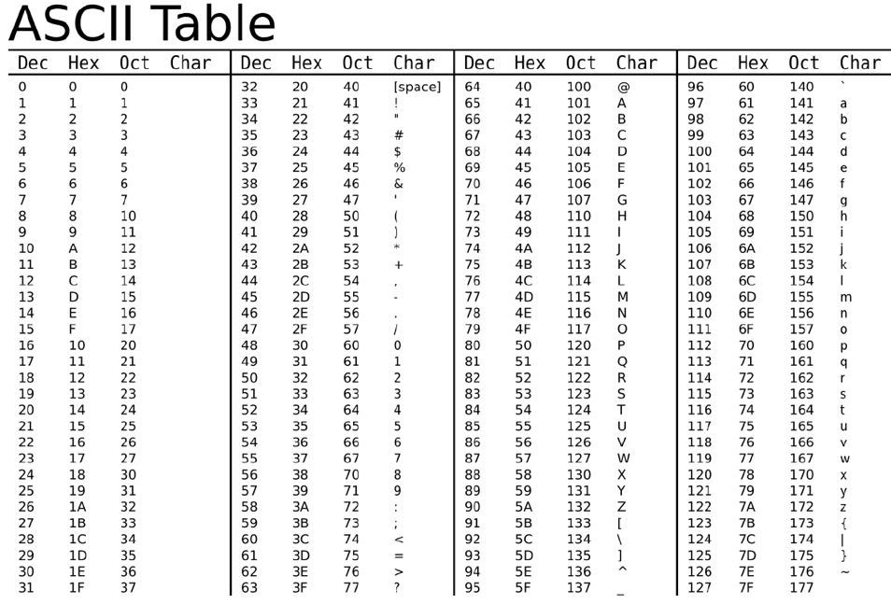
Decode into characters the following hexadecimal string:
0x5468697320697320746f6f20656173792021
Impt: Each character will correspond to a unique 7-bit value (represented with two hexadecimal characters)
Impt: the prefix 0x is often used to denote an hexadecimal representation

Slide 52
Decode into characters the following hexadecimal string:
Qn: 0x5468697320697320746f6f20656173792021
Ans: This is too easy!

Slide 53
8. What value will be present in memory position 0x6f after finishing executing the instructions? Use the Fetch-Decode-Execute cycle and consider that we are using 16-bit size instructions.

Slide 54
What do we know?
CPU has 4 registers RA, RB, RC, RD
16-bit system --- use hexadecimal code
Notation: 0x1Aij --- 0x 1 A ij
0x (denotes hexadecimal; can ignore)
1 (1 means to sum)
A (place in register A)
i and j are the 2 data to be summed

Slide 55
What do we know?
Notation: 0x {1,2,3,4} {A,B,C,D} ij
0x (denotes hexadecimal; can ignore)
1: Sum, 2: Subtract, 3: Load, 4: Save
A,B,C,D (place in register A,B,C,D)
i and j are the 2 data to be dealt with

Slide 56
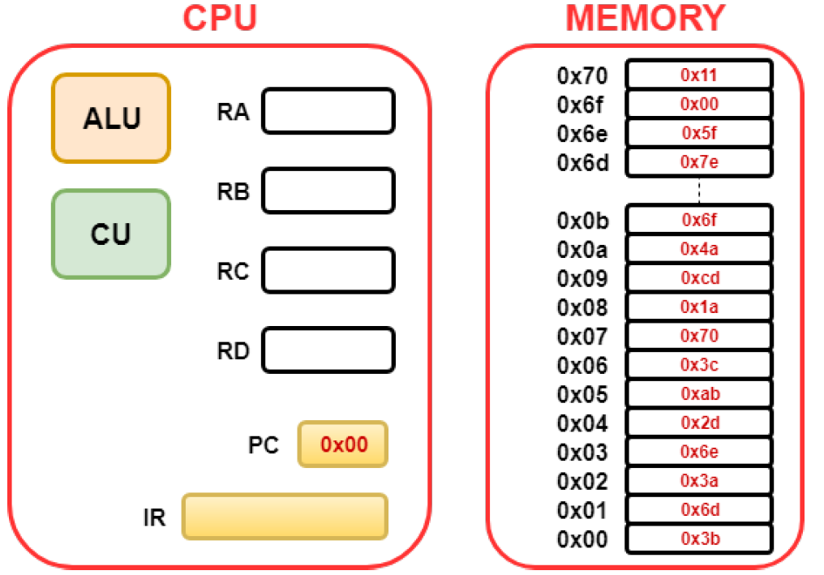
The Fetch-Decode-Execute cycle

Slide 57
PC state | Operand |  | Instruction |  | Hex Value
0 | 3b | 6d | Load data into position B | From 6d | 7e
2 | 3a | 6e | Load data into position A | From 6e | 5f
4 | 2d | ab | Subtract and store in D | b - a | 7e – 5f = 1f
6 | 3c | 70 | Load data into position C | From 70 | 11
8 | 1a | cd | Sum and store in A | c+ d | 1f+11 = 30
A (remember A is 10) | 4a | 6f | Save data in register A | To location 6f | 30
Hint: Use a hex calculator to speed things up https://www.calculator.net/hex-calculator.html

Slide 58
9. Describe what values should be written in the memory in order to compute the addition of 0x44 and 0x55, and placing the result into memory position 0x70.

Slide 59
PC state | Operand |  | Instruction |  | Hex Value
0 | 3a | 6d | Load data into position A | From 6d | 44
2 | 3b | 6e | Load data into position A | From 6e | 55
4 | 1c | ab | Sum and store into C | a + b | 55 + 44 = 99
6 | 4c | 70 | Save value in position C | To location 70 | 99
Only needs 4 cycles --- PC will stop at 6

Slide 60
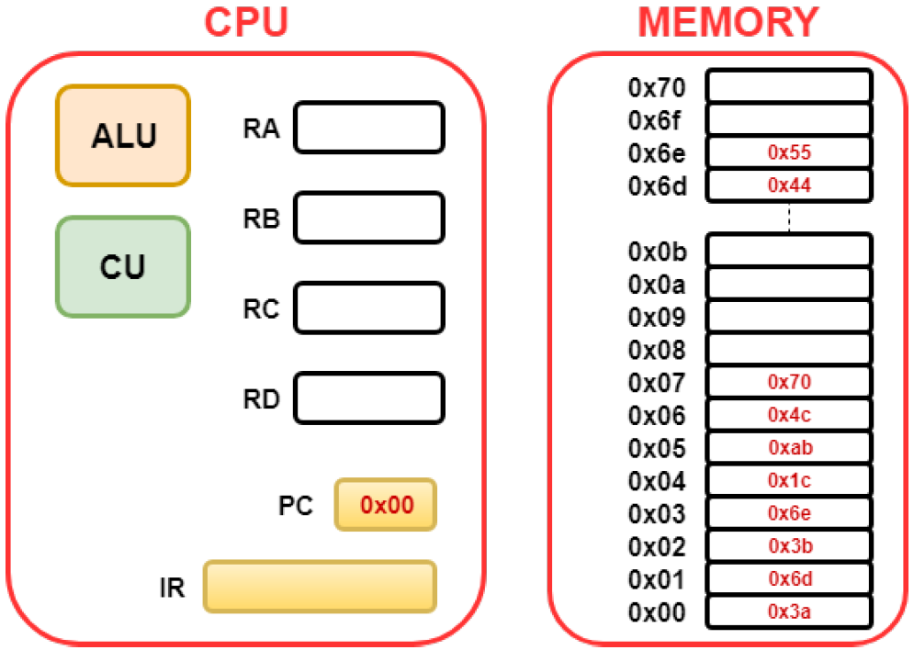

Slide 61
The end!

Slide 62
New instruction for practical
When logged into the RPi. Open command line.
Go to “/Desktop/”
Key in command ”ls”
If you see a file named “helloworld”
Type in ”rm hello*.*”
Proceed with the rest of practical as normal
At the end of the practical, please also delete and remove your helloworld files. Thanks! ☺

Slide 63
Copyrights
This set of tutorial explanations belongs to Wil Goh (except the kitten pictures).

